Slide 1
Engineering Chemistry
Unit V
Spectroscopic Techniques
Topic: UV-Vis Spectra and applications
Department of Applied Science
Pune Institute of Computer Technology, Pune

Slide 2
UV-Vis Spectra
UV-Visible spectrophotometer on analysis of an analyte solution gives data in the form of UV-Vis Spectra or UV-Vis spectral data that can be converted in the spectra.
Here the absorption of UV-Visible light leads to excitation of electrons from bonding molecular orbital to antibonding molecular orbital.
This absorption depends on structure of analyte.

Slide 3
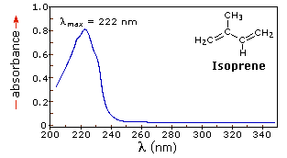
UV-Vis Spectra
The UV-Vis spectra for isoprene is as follows
Source: https://www2.chemistry.msu.edu/faculty/reusch/VirtTxtJml/Spectrpy/UV-Vis/spectrum.htm

Slide 4
UV-Vis Spectra
The UV-Vis spectra is a graph of Absorbance or % Transmittance on Y axis and Wavelength on X axis.
It gives information about:
λ_{max} = It is the wavelength at which maximum absorbance is observed. It is a charactristic property of a analyte and depends on strucutre of that analyte.

Slide 5
Applications of UV-Vis Spectroscopy
Structural Information: λ_{max} is the characteristic property of a molecule due to presence of chromophore along with auxochrome. By knowing this value structural information can be extracted.
Qualitative analysis: UV-Vis spectra of a unknown sample can be matched with spectra of known compound to analyse sample qualitatively.

Slide 6
Applications of UV-Vis Spectroscopy
Chemical Kinetics: According to Beer’s Law absorbance is proportional to concentration. Hence during the chemical reaction absorption intensity of reactant decreases, while that of Product increases which will help to study chemical kinetics.
Detection of Impurity: Any change in the spectra of a specific compound will indicate the presence of impurity .

Slide 7
Applications of UV-Vis Spectroscopy
Quantitative analysis: By use of UV-Visible Spectroscopy, unknown concentration of analyte can be evaluated. Here same analyte solution is prepared with different concentration and its absorption is determined. A graph is plotted with absorption verses concentration, which gives a straight line.
Now absorption of solution containing unknown concentration is evaluated and by use of graph its corresponding concentration can be determined.

Slide 8
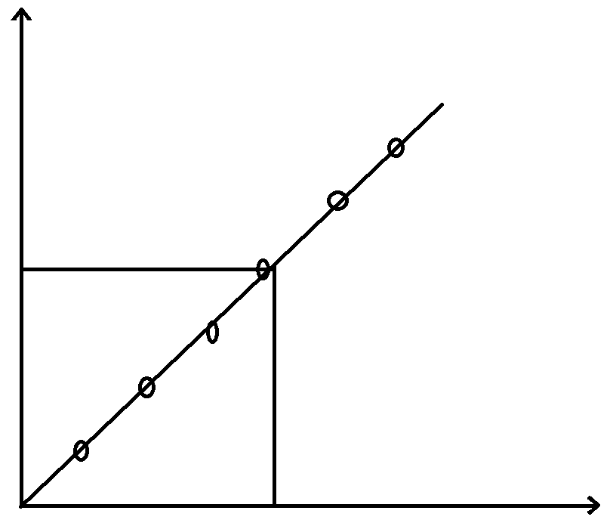
Applications of UV-Vis Spectroscopy
Absorption
Concentration

Slide 9
Thank you

